Slide 1


Forecasting Microsoft's Stock Price
A Time-Series Historical Analysis from 1986 to 2023

Slide 2




Team Introduction
Amy Sun
Rita Cui
Serena Zhao
Steven Luo
Notes:
P1-P6 Steven – 2min以内
P7-

Slide 3
Agenda
Problem Statement
Data Properties and EDA
Feature Engineering
Results and Future Work
Assumptions/
Hypotheses
Data Processing and Transformations
Proposed Models

Slide 4
Problem Statement
01
In this project, we aim to develop robust forecasting models to predict Microsoft's future stock prices using historical data from 1986 to 2023.
02
By leveraging a comprehensive dataset that includes daily closing prices, high and low prices, and trading volumes, we will explore and analyze the stock market trends and patterns associated with Microsoft's performance.
03
Our primary objective is to create accurate forecasting models that can predict future stock prices, providing valuable insights for investors, analysts, and financial enthusiasts.

Slide 5
Assumptions/Hypotheses
about Data and Modeling
Stationarity Assumption
We assume that the time series data of Microsoft's stock prices is non-stationary but can be transformed to stationary through differencing or other techniques. This is crucial for applying most time series forecasting methods effectively.
Seasonality Hypothesis
We hypothesize that there are seasonal effects in Microsoft's stock prices. For instance, there might be specific trends during different months or quarters, influenced by factors such as product launches and market conditions, etc.
Impact of External Events
We assume that significant external events (e.g., economic crises, technological breakthroughs, changes in leadership) have a notable impact on Microsoft's stock prices. These events need to be considered when developing forecasting models.

Slide 6
Assumptions/Hypotheses
about Data and Modeling
Correlation between Variables
Trading volume data provides an additional dimension for understanding Microsoft's stock market activity. It highlights the level of investor interest and participation in buying and selling Microsoft shares during each trading day.
We hypothesize that there is a significant correlation between the stock prices and trading volumes. High trading volumes might be associated with significant price movements, indicating investor sentiment and market activity. Correlation analysis will be conducted to validate this hypothesis.
Modeling Assumption
We assume that a combination of different time series models (ARIMA, SARIMA, Exponential Smoothing (ETS), TBATS, ARMA and GARCH Combination) will provide a comprehensive approach to forecasting, allowing us to compare and select the best-performing model based on accuracy metrics.

Slide 7
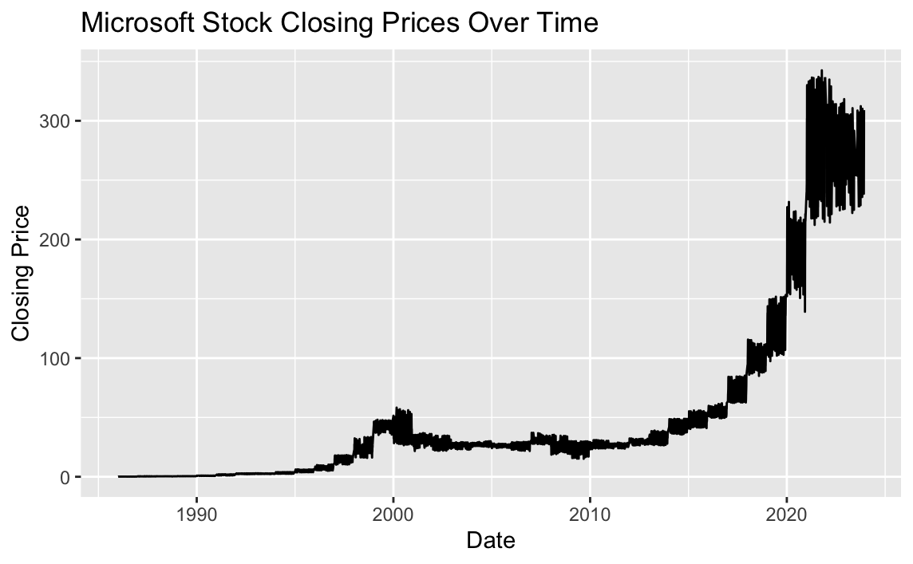
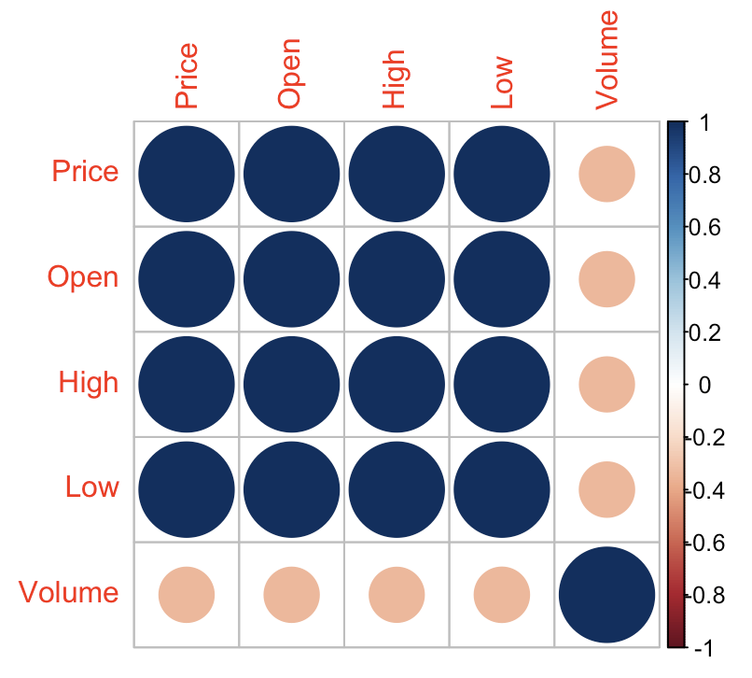
Data Properties and EDA
Target variable: Price
A substantial increase in stock prices, especially post-2013, reflecting Microsoft’s growth and market performance.
Check missing values
Date column conversion
Mean Closing Price: 48.09;
Median: 27.09
Maximum: 343.11
1
Summary Statistics
2
Closing Prices over time
ADF test result: Dickey-Fuller = -3.132, p-value = 0.09951.
The series is non-stationary (p-value>0.05), indicating the need for differencing and transformation for time series modeling.
3
4
High positive correlations among price-related columns (Price, Open, High, Low).
Moderate correlation between Price and Volume, indicating some relationship between trading activity and stock price.
Stationary Chek
Correlation Analysis

Slide 8
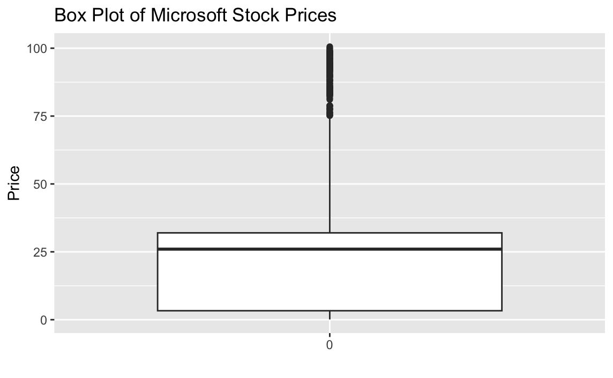
Data Processing
Data Cleaning
Anomaly Detection
1
Removed detected outliers to clean the dataset.
Checked for missing values and applied linear interpolation (na.approx) for imputation.
Ensured only numeric columns were imputed.
4
2
3
The majority of stock prices are within the interquartile range (IQR), between approximately $0 and $50.
Significant number of outliers are observed above $75, indicating periods of rapid stock price increase.
Stationarity Check
Performed Augmented Dickey-Fuller (ADF) test on differenced data.
Confirmed stationarity post-differencing.
Transformations
Applied differencing to the closing prices to make the series stationary.
Removed NA values introduced by differencing.
Notes:
We use boxplot method to detect outliers (2:40)

Slide 9
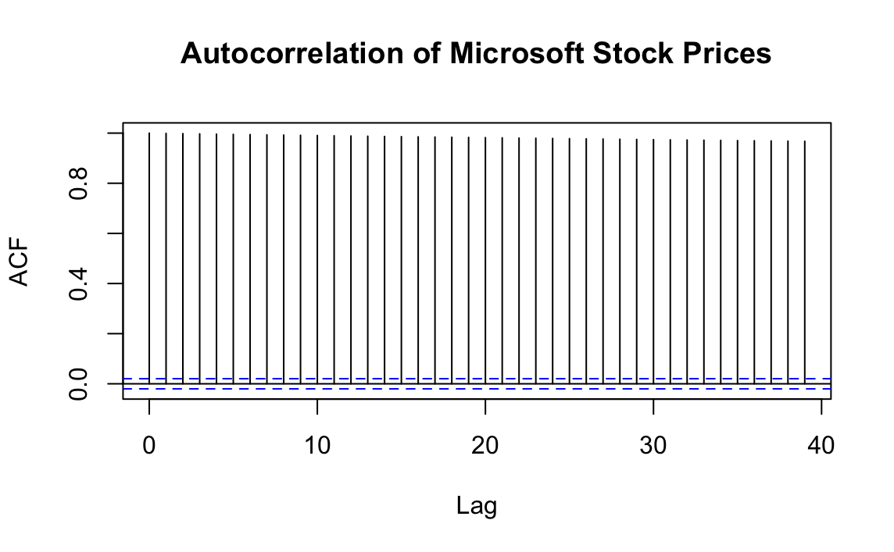
Feature Engineering
Incorporate past values of the stock price and trading volume as features for modeling and analysis. Using the mutate function to create new columns with lagged values.
Purpose & Method
Price_lag
Price_lag1: Previous Day’s Stock Price
Price_lag2: Stock Price from two days prior
Volume_lag1: Previous Day’s trading volume
Volume_lag2: Trading Volume from two days prior
Volume_lag
Using drop_na() to remove any rows with missing values after creating lagged features.
Handling Missing Values

Slide 10
Proposed Models
ARIMA
ARIMA combines autoregressive (AR) terms, differencing (I) to make the time series stationary, and moving average (MA) terms.
TBATS
TBATS (Trigonometric, Box-Cox transform, ARMA errors, Trend, and Seasonal components) is chosen for its flexibility in handling complex seasonal patterns and long-term trends, making it suitable for data with multiple seasonalities.
SARIMA
SARIMA extends ARIMA to support seasonal components. It's selected for datasets with strong seasonal patterns, allowing for more accurate modeling of seasonally varying trends in the data.
ARMA-GARCH
ARMA-GARCH models combine ARMA for capturing mean behaviors and GARCH for modeling volatility, making it ideal for financial time series with changing volatility over time.
HW (Holt-Winters)
The Holt-Winters (HW) method is chosen for its effectiveness in forecasting data with trends and seasonality.

Slide 11
Proposed Models
- Metrics Focused
Root Mean Square Error (RMSE)
Penalizes larger errors more than smaller errors, making it sensitive to outliers
Sensitivity to large errors makes it a good metric for identifying models that might produce significant deviations from actual values
3. Mean Absolute Percentage Error (MAPE)
It expresses the error as a percentage, making it easy to interpret and compare across different datasets or models
A relative measure of the forecast accuracy, which helps in comparing the performance across different time series with varying scales
2. Mean Absolute Scaled Error (MASE)
Useful because it provides a scaled error metric that allows for comparison across different time series and models
It is particularly valuable when we have seasonal data or when we want to ensure that the model is performing better than a simple naive benchmark

Slide 12
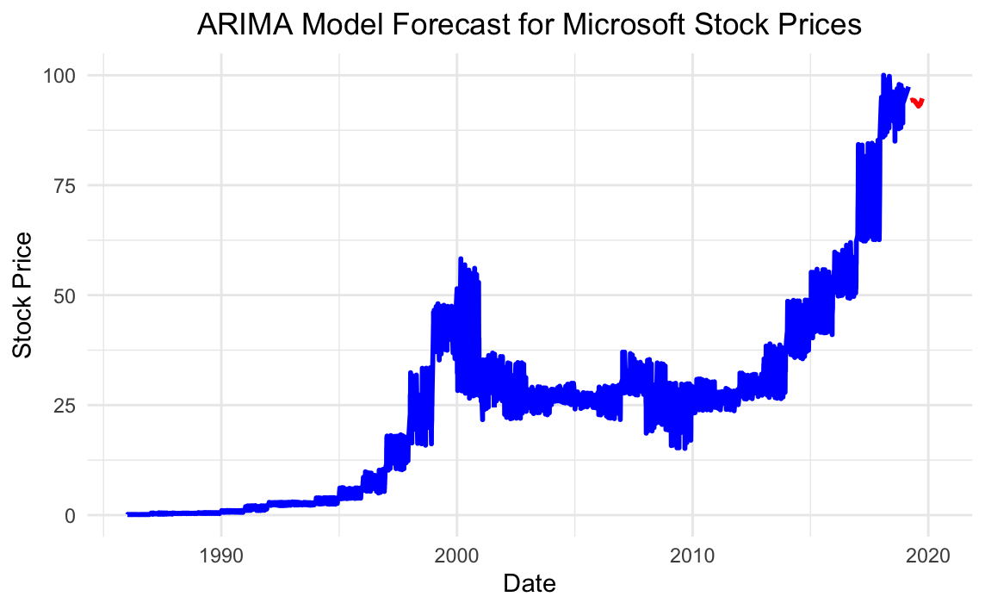
Error Measures on Training Set:
RMSE (Root Mean Square Error): 1.588302
MAPE (Mean Absolute Percentage Error): 1.571954
MASE (Mean Absolute Scaled Error): 0.998898
Noticeable trends include steady growth, sharp increases, and periods of volatility
Early 2000s: Significant spike (dot-com bubble).
Late 2010s: Sharp increase in stock price.
The ARIMA model used for forecasting captures the general trend and seasonal patterns
Steep rise in stock prices in recent years

Slide 13
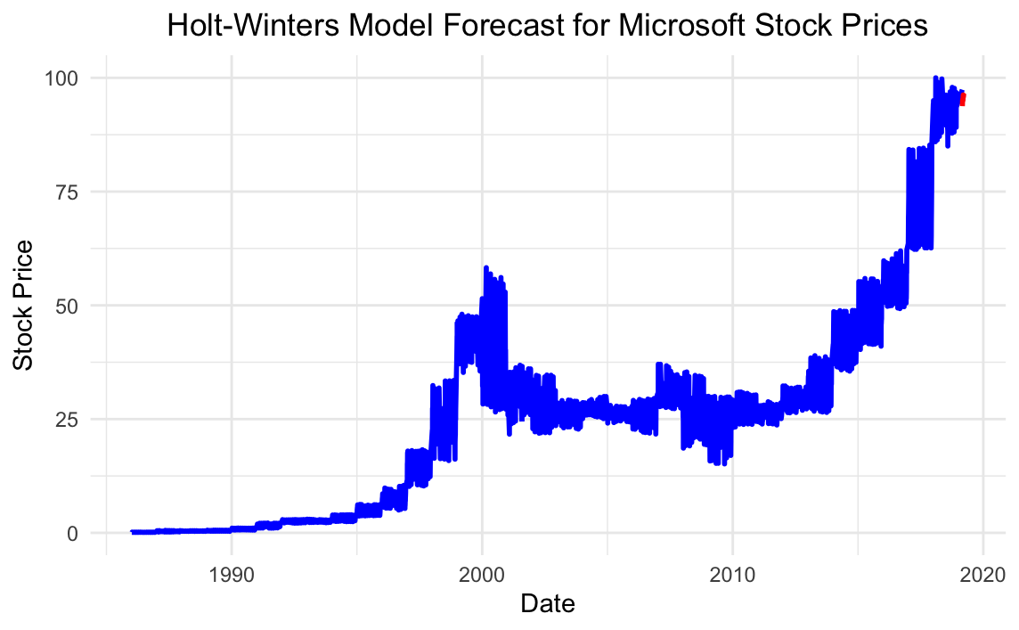
Error Measures on Training Set:
RMSE (Root Mean Square Error): 0.5717961
MAPE (Mean Absolute Percentage Error): 1.533816
MASE (Mean Absolute Scaled Error): 0.06115833
Stabilization Phases: The periods following major market corrections (post-2002 and post-2008) show more stable growth, indicating recovery and investor confidence.
Significant growth observed in stock prices, especially post-2010.
High fluctuations in recent years
Holt-Winter model : Exponential smoothing with trend and seasonality.
model forecasts continued growth with seasonal fluctuations.

Slide 14
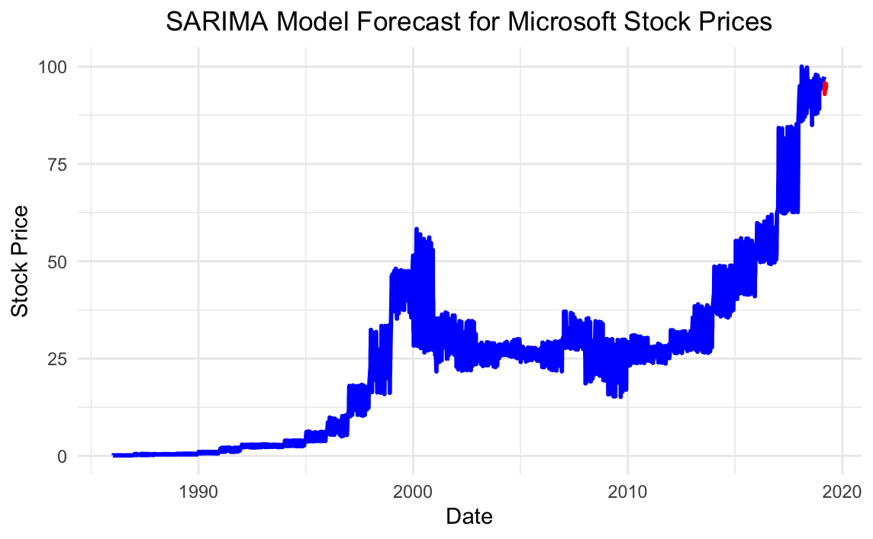
Error Measures on Training Set:
RMSE (Rox aot Mean Square Error): 2.93
MAPE (Mean Absolute Percentage Error): 12.57%
MASE (Mean Absolute Scaled Error): 0.81
Late 2010s: Sharp rise in stock prices, reflecting Microsoft's growth in the tech industry.
The model predicts a continued upward trend in stock prices.
SARIMA model effectively captures historical trends and provides a robust forecast for future values.
Early 2000s: Significant fluctuations due to the dot-com bubble.

Slide 15
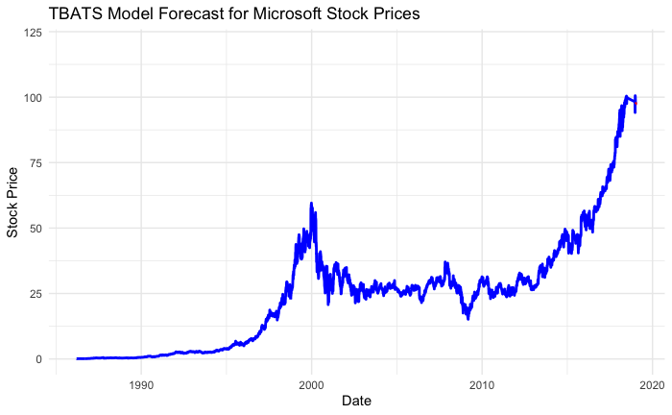
Error Measures on Training Set:
Root Mean Square Error (RMSE): 0.02833636
Mean Absolute Percentage Error (MAPE): 1.09201
Mean Absolute Scaled Error (MASE): 0.06286343
TBATS effectively captures seasonality and long-term trends, providing a comprehensive understanding of the underlying patterns.
The graph demonstrates a clear upward trend in Microsoft's stock prices over time, particularly noticeable from the mid-1990s onward. This trend highlights the company's growth and increasing market value, especially in the tech boom periods.
Following the 2008 financial crisis, the stock price shows a more stable upward trend with less pronounced volatility compared to earlier years. This stability indicates Microsoft's resilience and solid performance in the aftermath of the global economic downturn.
The TBATS model forecast suggests a continuation of the upward trend, reflecting the model's ability to capture and project existing patterns. However, the forecasted values are relatively conservative, not predicting extreme spikes or drops, which may be a trade-off for a more stable and less volatile forecast.

Slide 16
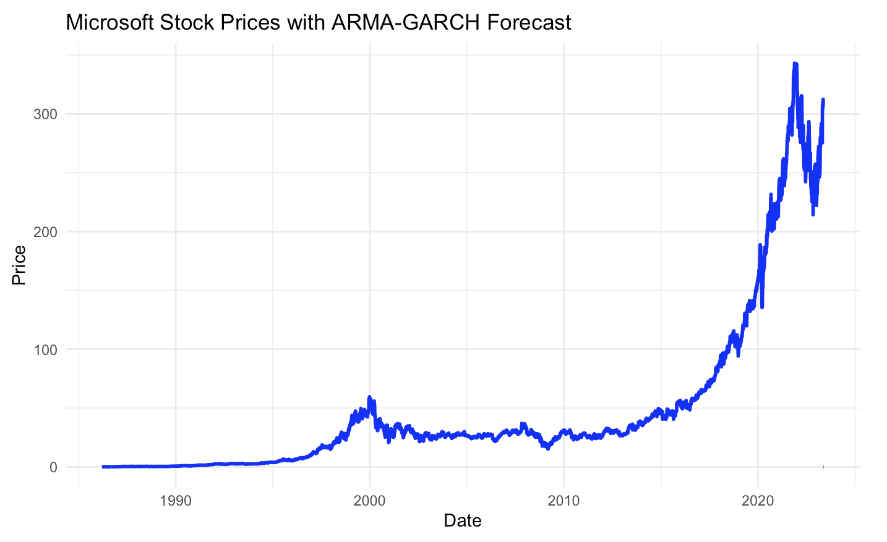
Error Measures on Training Set:
RMSE (Root Mean Square Error): 1.987949
MAPE (Mean Absolute Percentage Error): 0.01904492
MASE (Mean Absolute Scaled Error): 1.273061
Accuracy: The ARMA-GARCH model provided a reasonable forecast of Microsoft stock prices.
Performance: Low RMSE and MAPE values indicate good predictive accuracy. MASE slightly above 1 suggests performance similar to a naive forecast but still better.
Room for Improvement: Exploring different model configurations, incorporating external factors, or using more advanced models might improve forecast accuracy.

Slide 17
Model Evaluation
 | RMSE | MAPE | MASE
ARIMA | 1.588302 | 1.571954 | 0.998898
SARIMA | 2.93 | 12.57% | 0.81
Holt-Winters | 0.5717961 | 1.533816 | 0.06115833
TBATS | 0.02833636 | 1.09201 | 0.06286343
ARMA-GARCH | 1.987949 | 0.01904492 | 1.273061
Notes:
RMSE (Root Mean Squared Error): Measures the magnitude of forecast errors.
MAPE (Mean Absolute Percentage Error): Measures the accuracy as a percentage.
MASE (Mean Absolute Scaled Error): Measures accuracy scaled by naive forecast errors.

Slide 18
ARIMA (AutoRegressive Integrated Moving Average):
Captures linear dependencies. Reasonable performance but higher errors compared to other models.
SARIMA (Seasonal ARIMA):
Extends ARIMA to capture seasonality. Relatively high RMSE and MAPE, indicating less accurate predictions.
Holt-Winters:
Uses exponential smoothing to capture trend and seasonality. Low RMSE and MASE, indicating good performance in capturing trend and seasonality.
TBATS:
Captures complex seasonal patterns. Very low RMSE and MASE, excellent in capturing complex seasonal patterns.
ARMA-GARCH:
Combines ARMA for mean and GARCH for volatility modeling. Low MAPE indicates good percentage accuracy, but RMSE and MASE suggest it is slightly less effective in comparison to Holt-Winters and TBATS.
Notes:
Key Takeaways:
TBATS Model: Most effective for Microsoft stock price forecasting due to its ability to capture complex seasonal patterns.
justification，

Slide 19
Best Model: TBATS
Complex Seasonal Patterns
The TBATS model is particularly well-suited for handling complex seasonal patterns and long-term trends, which might be present in the Microsoft stock price data.
Accuracy
The TBATS model outperforms the other models across all three key metrics. Lower values in these metrics indicate better performance and higher accuracy in predicting future stock prices.
Consistency
The consistency of low error metrics across different measures (absolute, squared, and percentage errors) reinforces the robustness of the TBATS model.
Notes:
The TBATS model excels across all key performance metrics, indicating superior accuracy in predicting future stock prices compared to other models. Its effectiveness in managing complex seasonal patterns and long-term trends, as well as consistently low error metrics, underscores its robustness for forecasting Microsoft stock prices.

Slide 20
Future Directions
Advanced Techniques
Machine Learning Models: Explore advanced machine learning algorithms such as Random Forest, Gradient Boosting, and Neural Networks for time series forecasting.
Hybrid Modeling Approaches
Combining Models: Investigate combining the strengths of multiple models, such as ARIMA and TBATS, or GARCH and TBATS, to capture both linear patterns and complex seasonality.
Ensemble Methods: Utilize ensemble learning techniques to integrate predictions from different models, potentially improving overall accuracy.
Incorporation of External Factors
Market Sentiment Analysis: Use sentiment analysis of news articles, social media, and financial reports to capture market sentiment, which can influence stock prices.
Notes:
Hybrid Modeling Approaches: Investigate combining strengths of models like ARIMA and TBATS, or GARCH and TBATS, to capture linear patterns and complex seasonality, and utilize ensemble learning techniques to integrate predictions for improved accuracy.
Advanced Techniques and External Factors: Explore advanced machine learning algorithms for time series forecasting and incorporate market sentiment analysis from news, social media, and financial reports to influence stock price predictions.

Slide 21
Thank You!

